Slide 1
CACHE POLICIES

Slide 2
What is CACHE
It’s a technique of storing a copy of data temporarily in rapidly accessible storage memory.
Cache stores most recently used words in small memory to increase the speed in which a data is accessed.
2 Types -> Instruction Cache and Data Cache

Slide 3
Cache HIT and miss
In case of WRITE, A CACHE HIT occurs when the ADDRESS to be written is found in the cache
In case of READ, when the requested data can be found in a cache

Slide 4
DIRTY BIT
This Bit indicates whether the Cache has been Modified (DIRTY) or not modified (CLEAN)
Each cache Block contains a Dirty Bit
Write to the Memory is only done, if the Dirty bit is set
This reduces the write operations on the memory

Slide 5
CACHE POLICIES
WRITE THROUGH
WRITE BACK
WRITE ALLOCATE
READ ALLOCATE

Slide 6
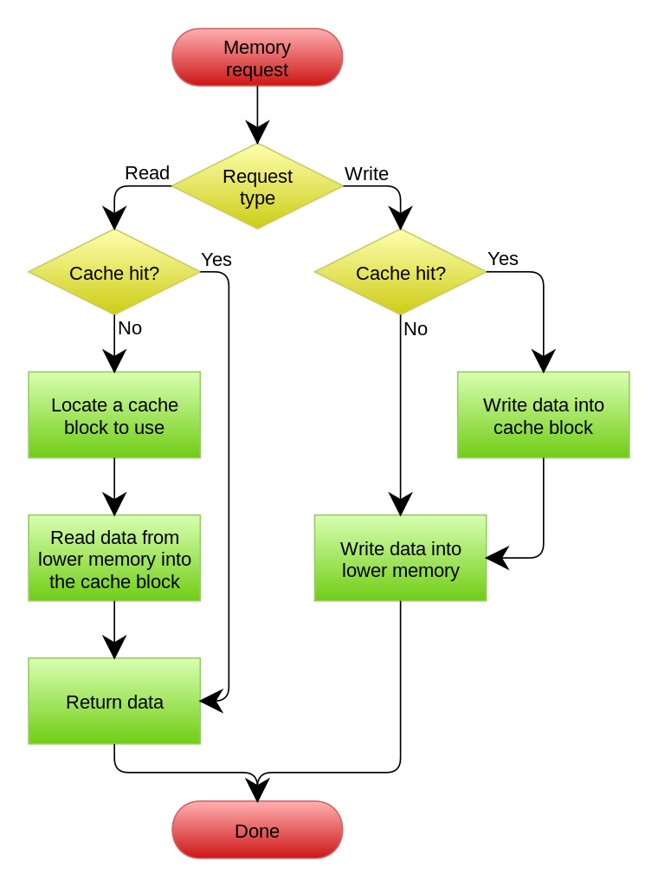
WRITE THROUGH
Data is simultaneously updated to cache and memory
Used when there are no frequent writes to the cache
This is safer for the data coherency, but it requires more bus accesses
Causes Multiple access to the memory

Slide 7
WRITE BACK
On HIT, it writes to the cache and sets the Dirty Bit
Memory can be updated Later, when the new data arrives in the cache
If there is MISS, then it Depends on WRITE ALLOCATE

Slide 8
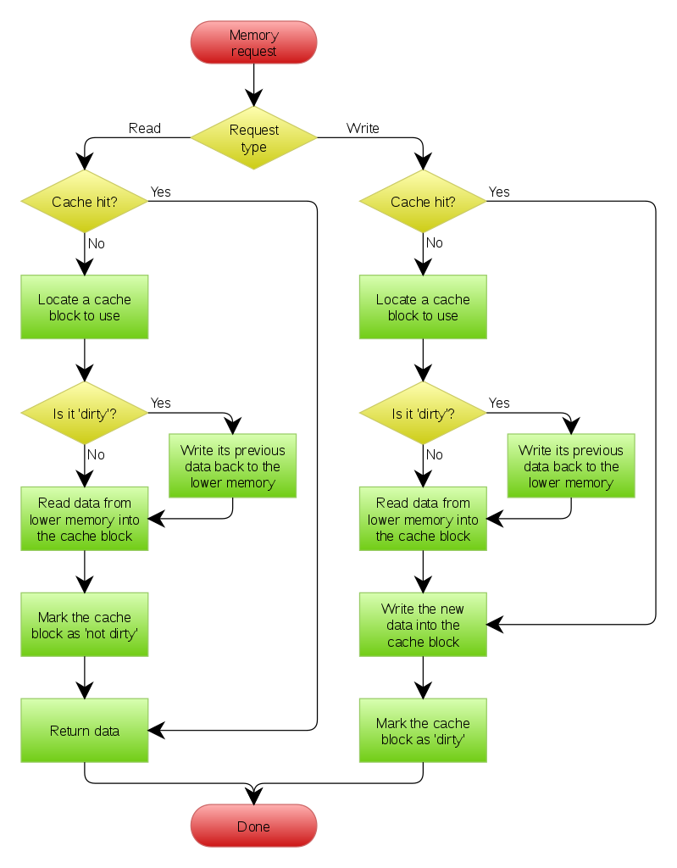
WRITE ALLOCATE
If there is a cache Miss in the Write Back
Data is loaded from the memory into cache
Data is updated into the cache and dirty bit is set for the next cycle
Write Back is mostly used with Write Allocate

Slide 9
READ ALLOCATE
All cacheable locations on Cortex-M7 based MCUs are read allocate.
This means that the data cache lines are allocated when a cache miss occurs, bringing 32 bytes of data from the main memory into the cache memory.
As a result, subsequent access to these memory locations will result in a cache hit condition, and the data is directly read from the cache memory

Slide 10
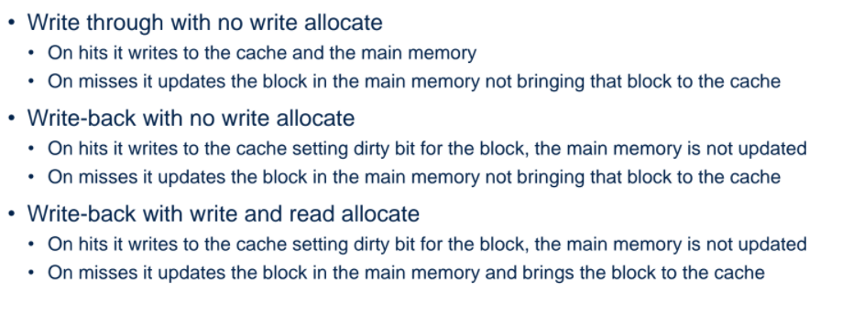
STM32 CACHE POLICIES

Slide 11
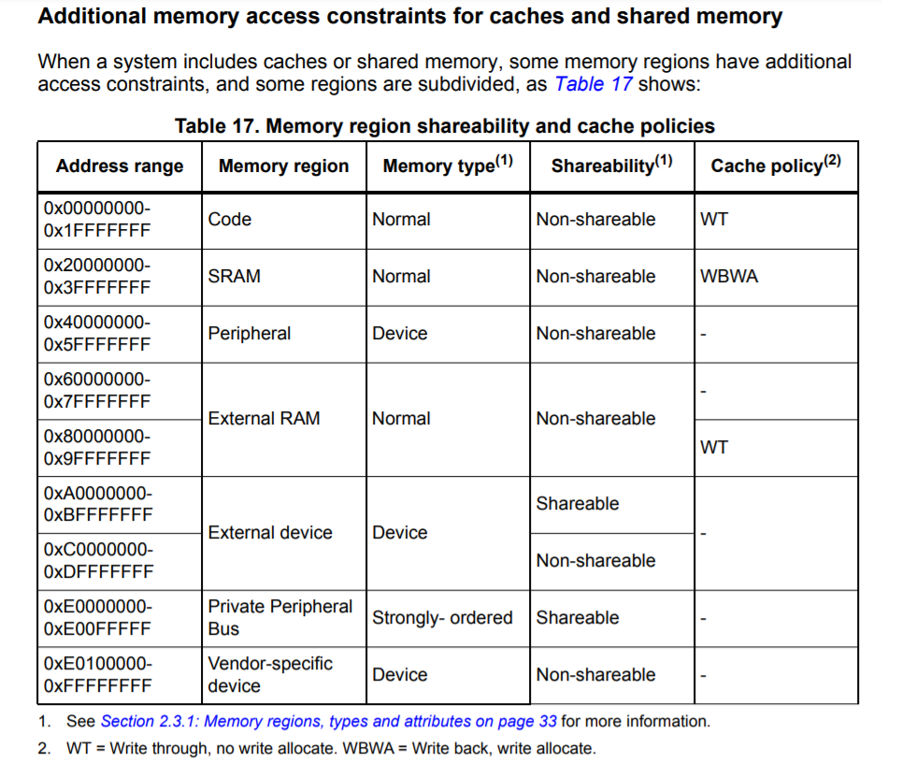
ATTRIBUTES in CORTEX M7

